Slide 1
Quant Team
Equal Weighting Factors
Brandon Ly (deduceBrandon@gmail.com), Ellie Evans, Mark Rose
(Silver Fund - 2020)
Notes:
Mark

Slide 2
Proposal
We can take an active equal-weight position in the BARRA factors that we have working right now
(We will show the results in this presentation)
But, we think it might be better to time factors, as interpretation and stock purchases will vary whether factor return is projected to be positive or negative.
We will develop the model to handle all BARRA factors and time them using meta-momentum (last time) by January.
Notes:
Mark

Slide 3
Biggest Problem(s)
Don’t have all BARRA factors that we want (working on this now)
BARRA factor returns are missing for 2020 (working on this now)
Factor returns need to be validated
Notes:
Mark

Slide 4
BARRA Factors

Slide 5
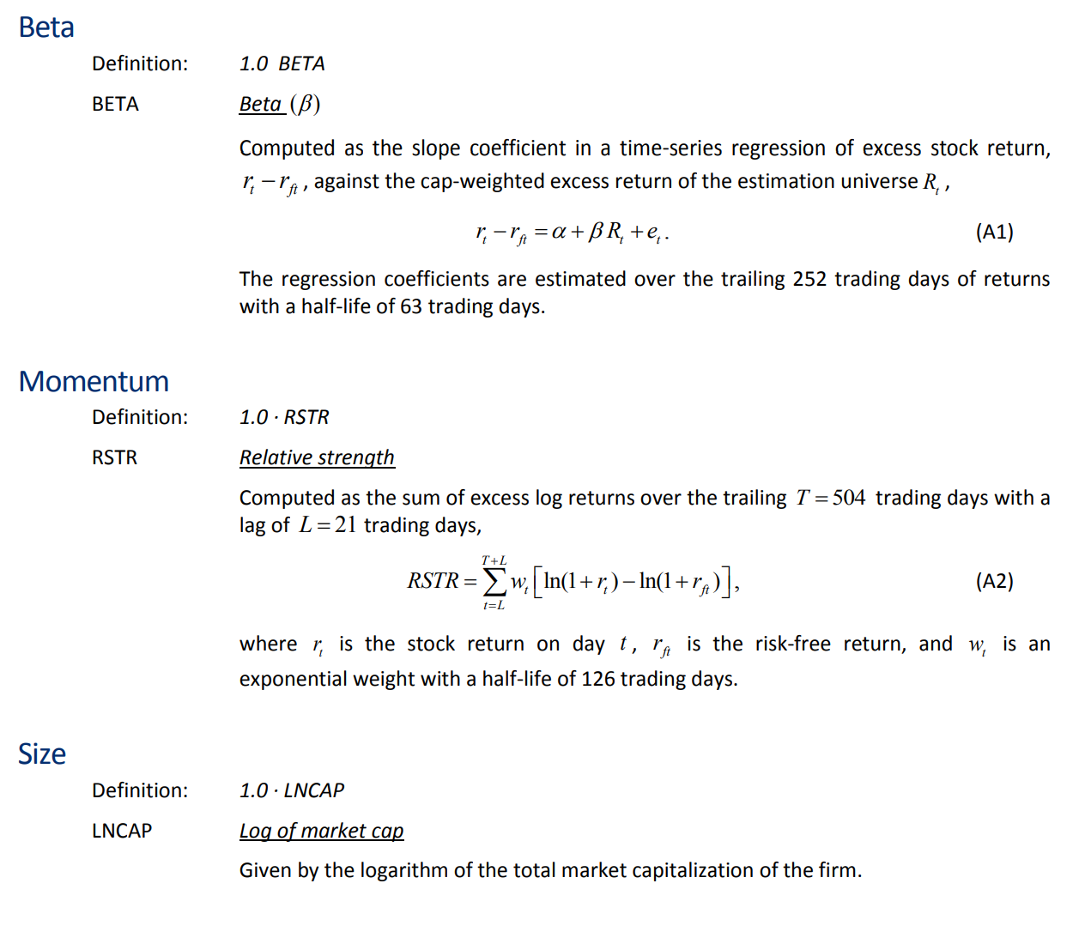
Notes:
Ellie

Slide 6
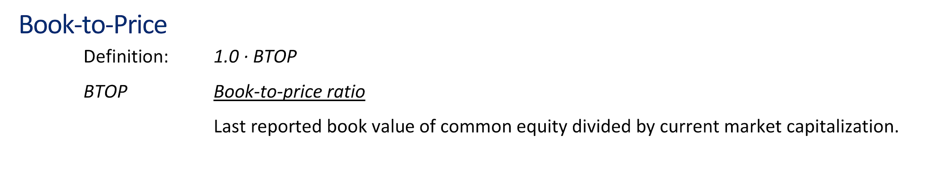
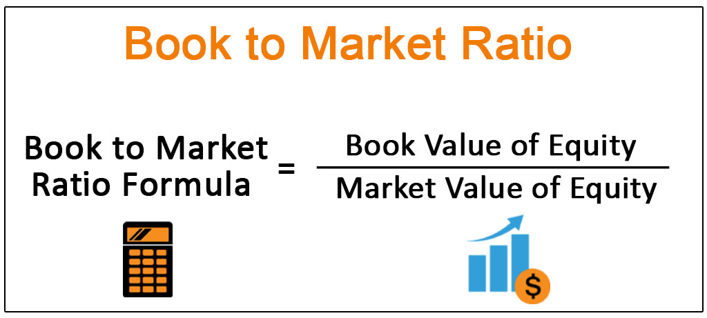
Captures excess returns to stocks that have low prices relative to their fundamental value
Notes:
Brandon

Slide 7
If the return to size is positive, we should buy big stocks (and vice versa). In contrast to Fama-French which shorts big stocks and goes long on small stocks.
Notes:
Mark

Slide 8
Higher Momentum = Reflects excess returns of stocks with stronger past performance
Notes:
Mark

Slide 9
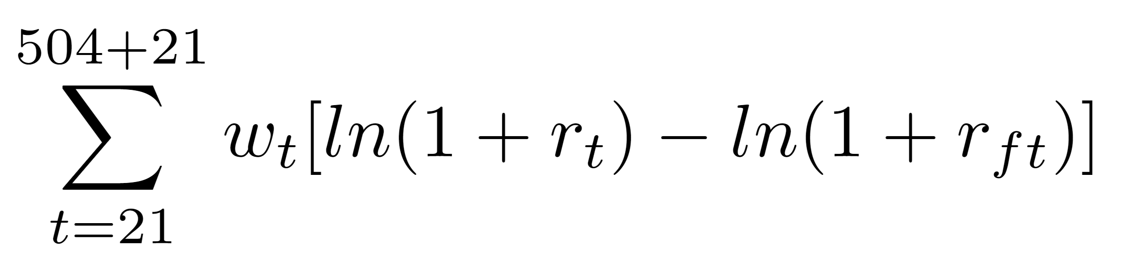
Momentum of a Stock
Two years prior
Two years prior
Stock Returns
Excluding most recent month
Exponential weight
Risk-free rate
Notes:
Mark

Slide 10
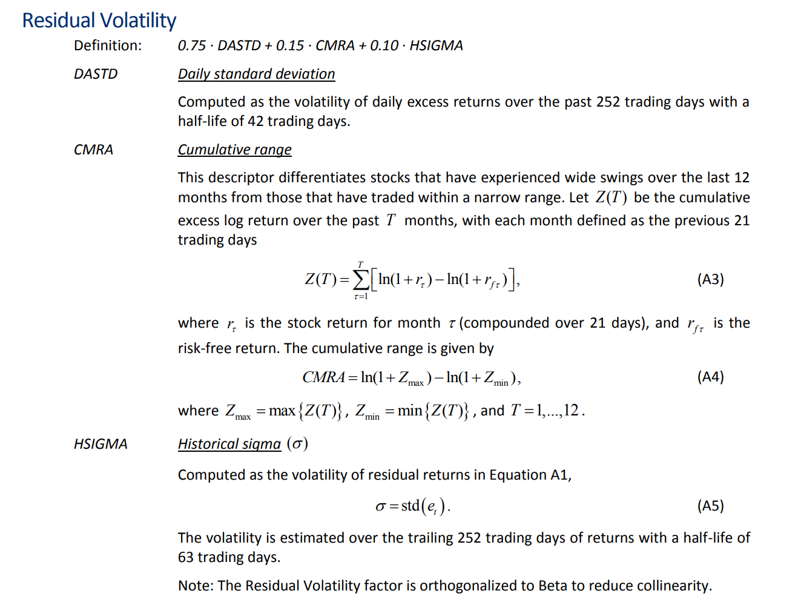
Captures excess returns to stocks with lower than average volatility, beta, and/or idiosyncratic risk
Notes:
Ellie

Slide 11
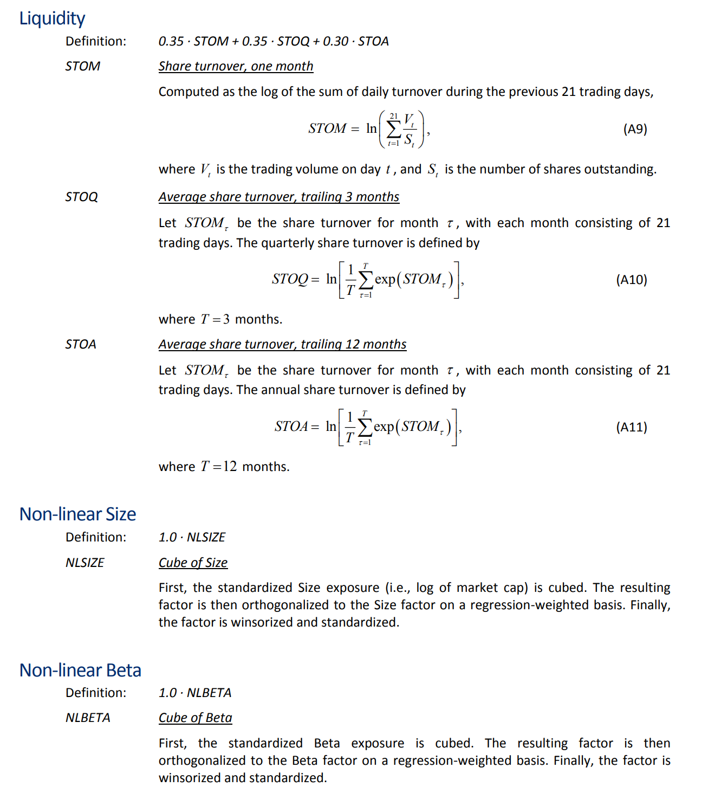
Cold stocks trade at a discount due to the difficulty associated with liquidity and Hot stocks are subject to heavier market scrutiny and therefore exhibit less mispricing.
Notes:
Brandon

Slide 12
Captures the idea that returns to size are nonlinear.
Notes:
Ellie

Slide 13
Equal - Weight Portfolios

Slide 14
BARRA
FAMA-FRENCH
An equal weight long strategy (excluding value) means:
Invest 1/7 into HIGH beta stocks
1/7 into HIGH size stocks
1/7 into HIGH momentum stocks
1/7 into HIGH volatility stocks
1/7 into HIGH liquidity stocks
1/7 into HIGH non-linear size
1/7 into HIGH non-linear beta stocks
An equal weight long strategy means:
Invest ¼ into HIGH beta stocks
¼ into LOW size stocks
¼ into VALUE stocks
¼ into HIGH momentum stocks
Opposite of a low-vol, low-beta strategy
Notes:
Brandon

Slide 15
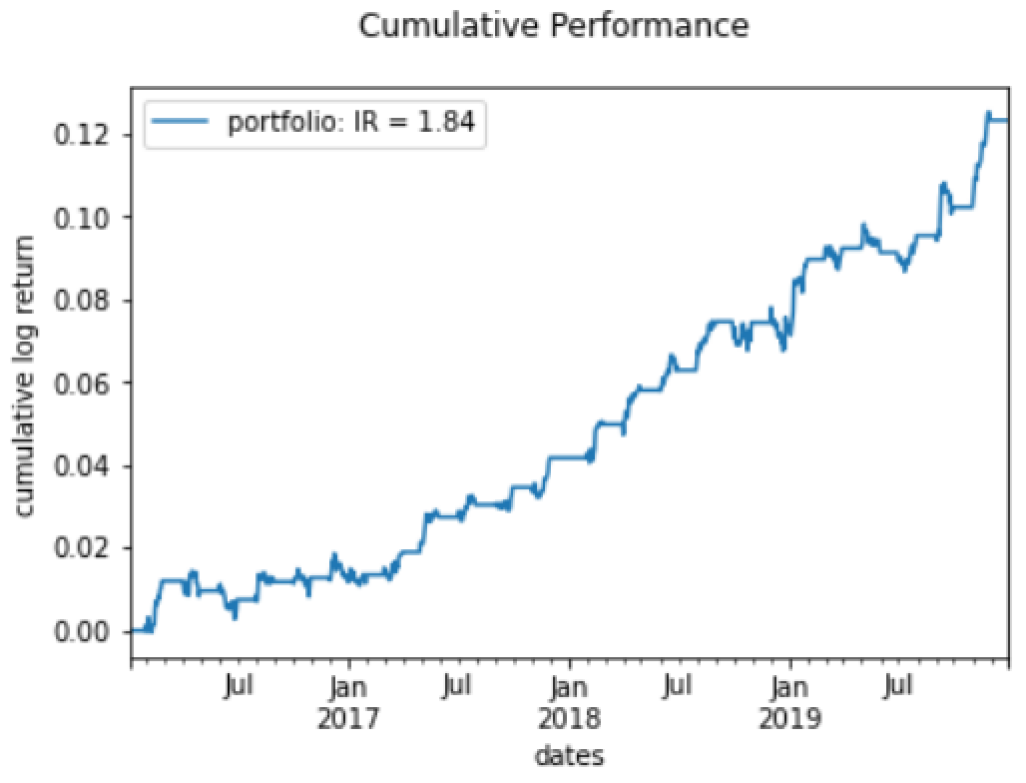
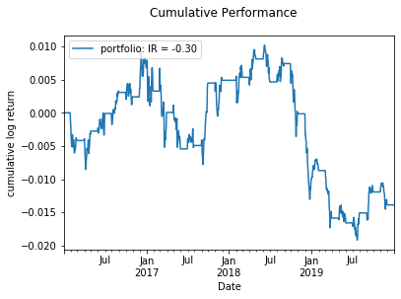
Equal-Weight BARRA Factors Portfolio Results (2016-2019)
Equal-Weight Fama-French Factors Portfolio Results (2016-2019)
Notes:
Ellie

Slide 16
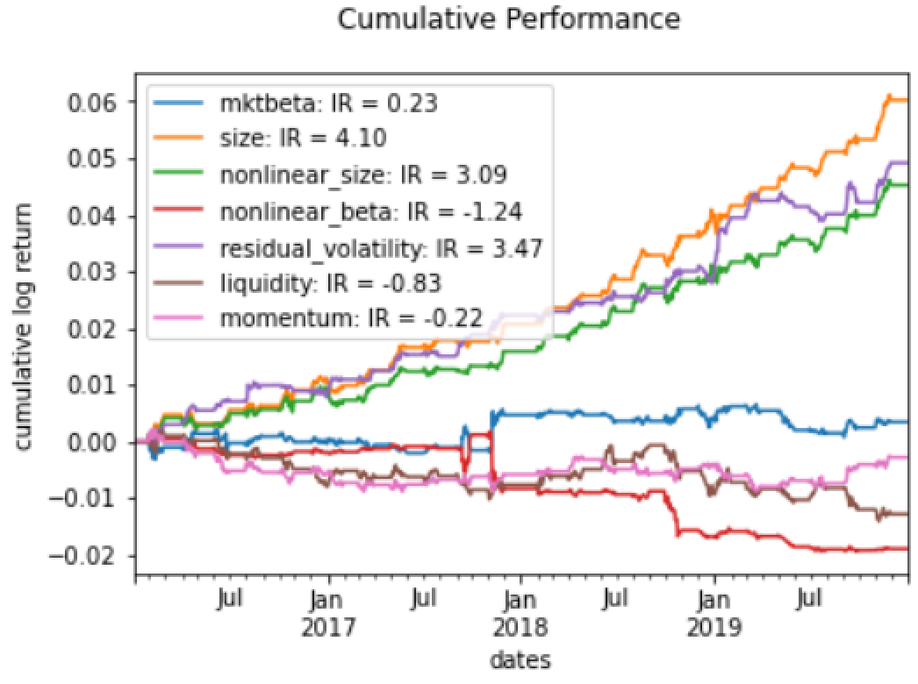
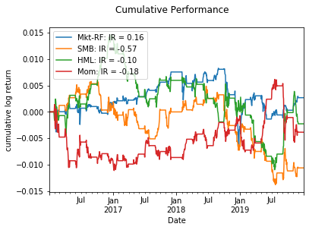
Cumulative Factor Returns - BARRA factors (2016-2019)
Cumulative Factor Returns - Fama-French factors (2016-2019)
Notes:
Ellie

Slide 17
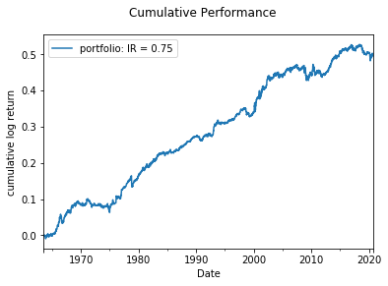
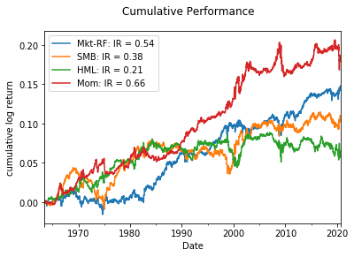
Fama-French factors (1963-2020)

Slide 18
Stock Examples (November 2020)

Slide 19
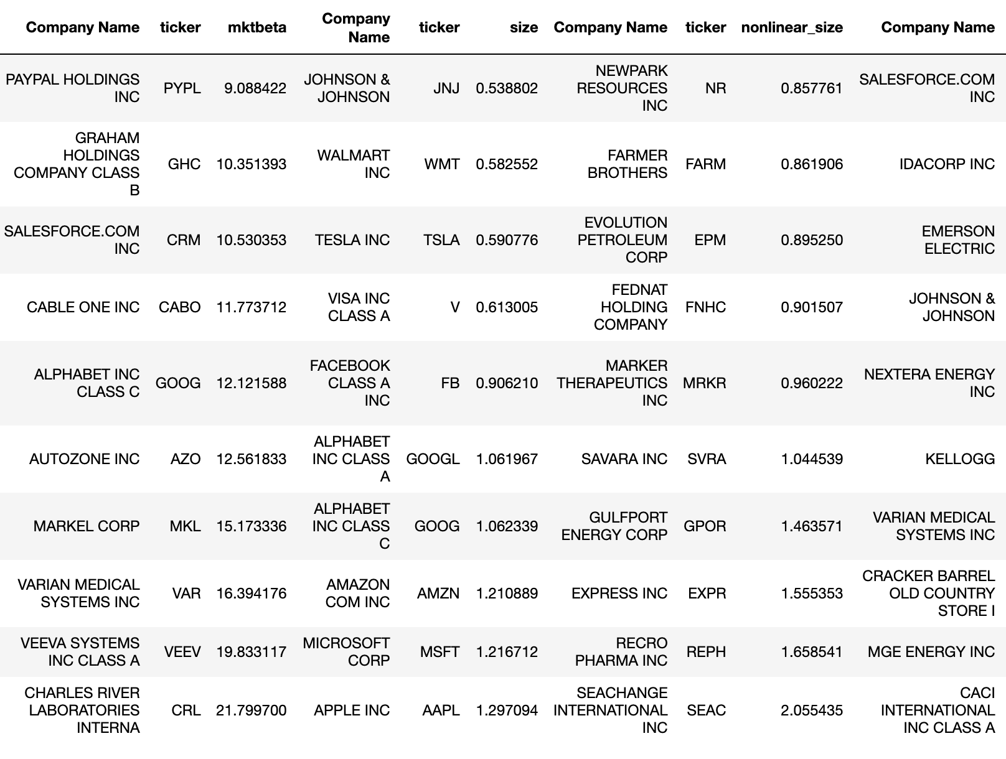
Going LONG on BARRA Factors = buy these stocks (Nov 5, 2020)
Notes:
Ellie

Slide 20
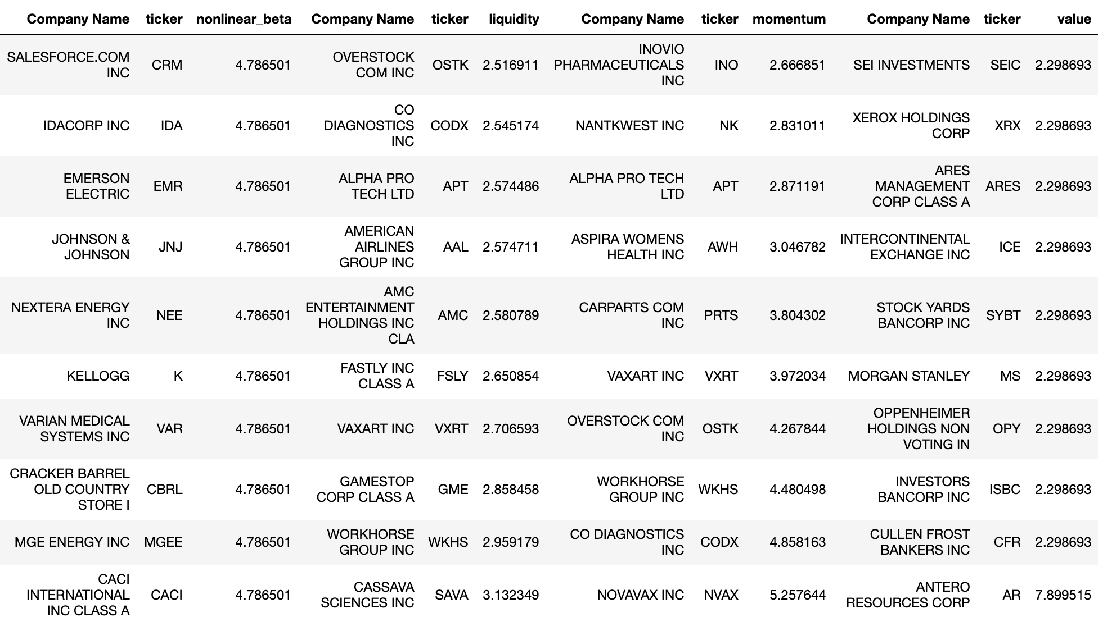
Notes:
Ellie

Slide 21
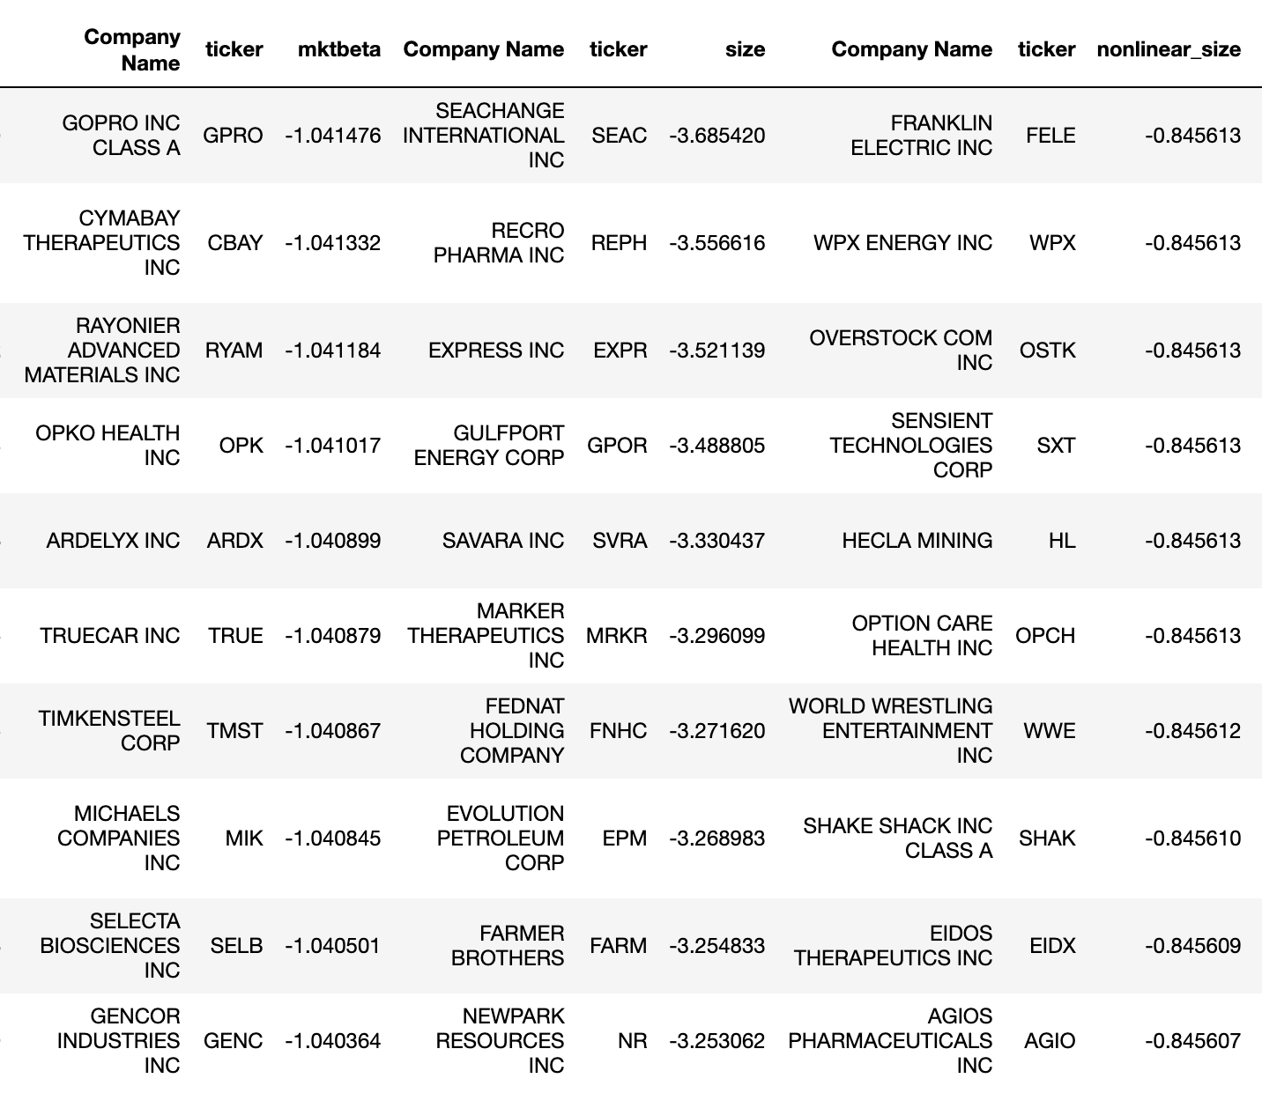
Going SHORT on BARRA Factors = buy these stocks (Nov 5, 2020)
Notes:
Mark

Slide 22
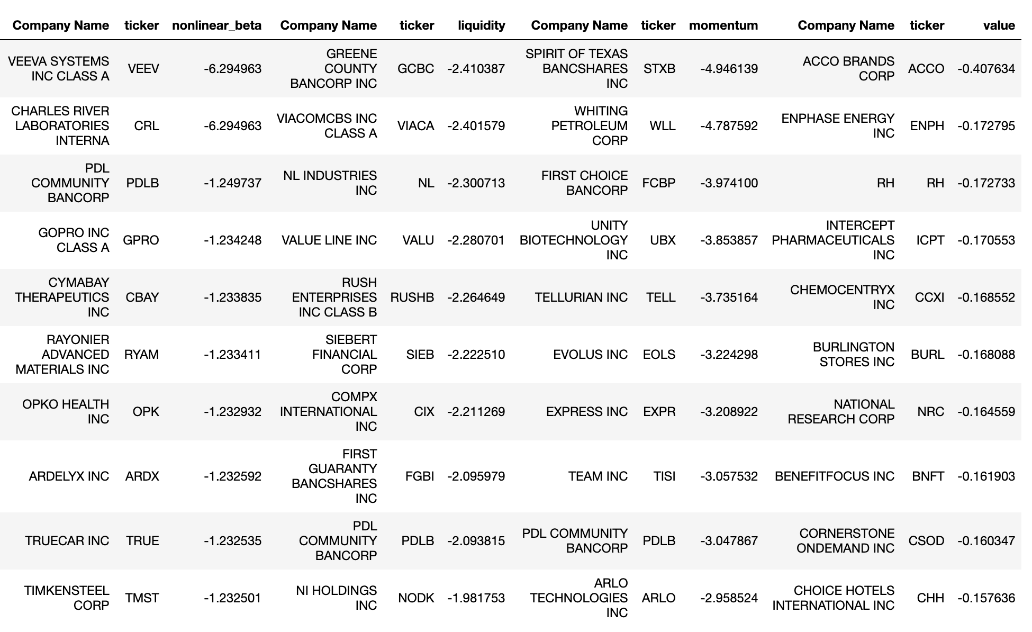
Notes:
Mark

Slide 23
Analyzing Correlations between Factors

Slide 24
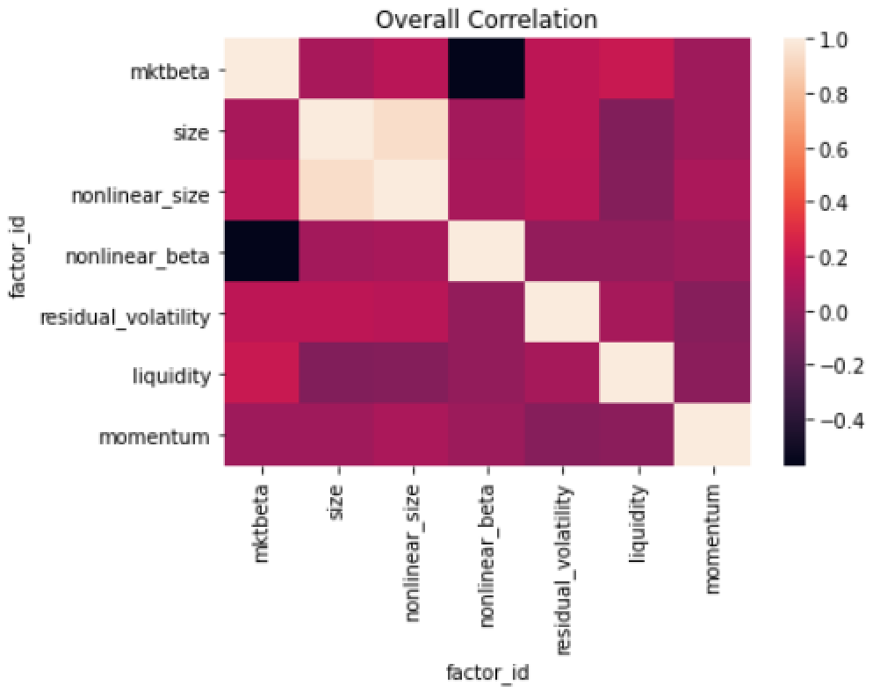
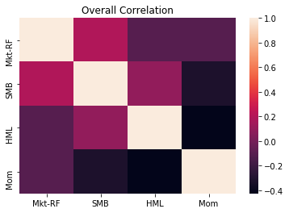
BARRA factors (2016-2019)
FAMA-FRENCH factors (2016-2019)
Notes:
Mark put together heat maps

Slide 25
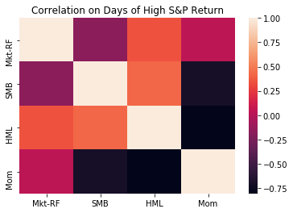
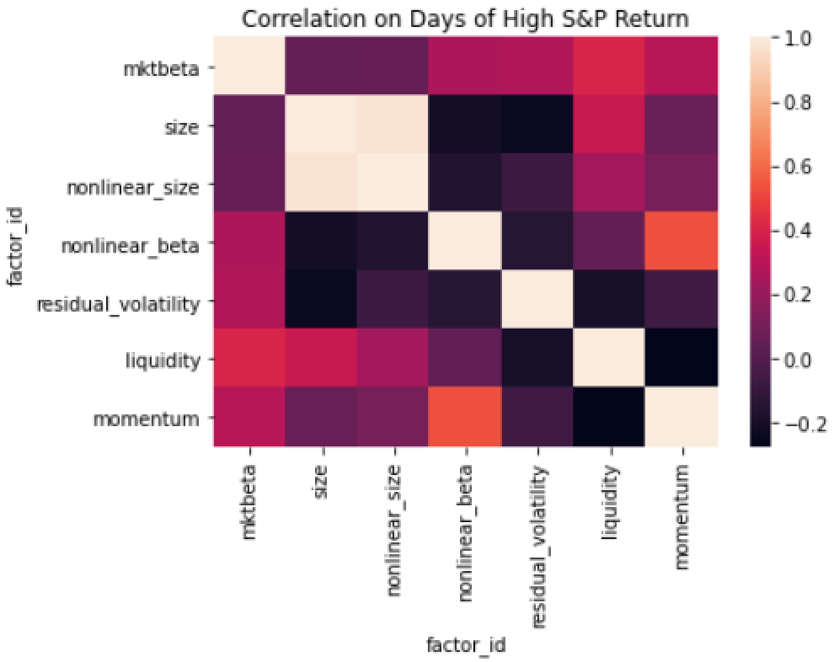
BARRA factors (2016-2019)
FAMA-FRENCH factors (2016-2019)

Slide 26
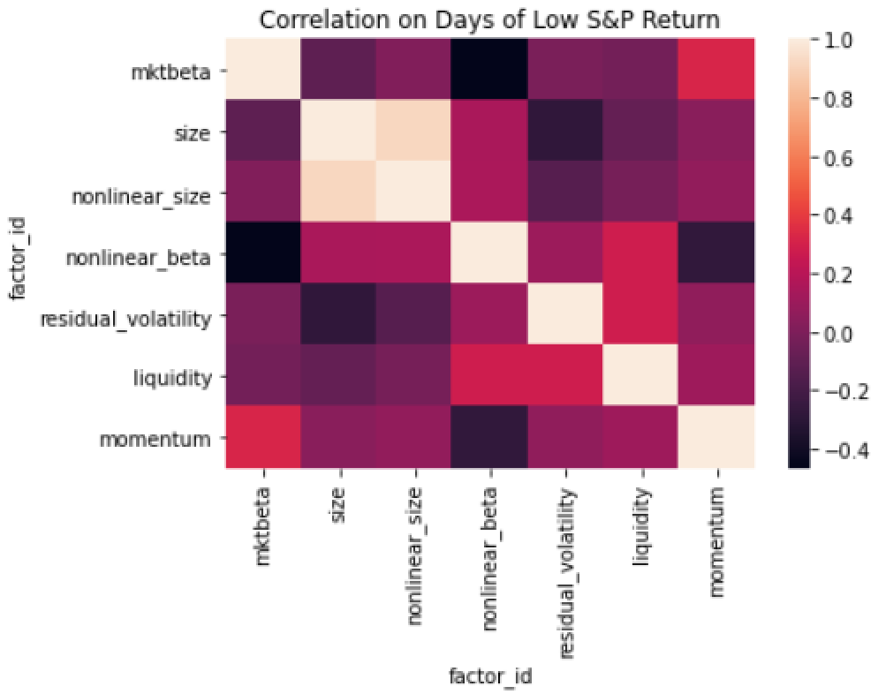
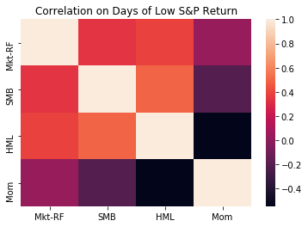
BARRA factors (2016-2019)
FAMA-FRENCH factors (2016-2019)

Slide 27
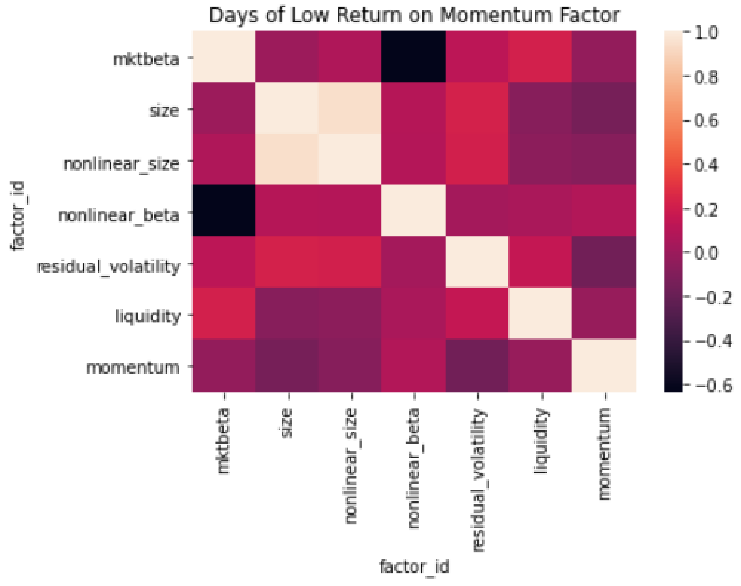
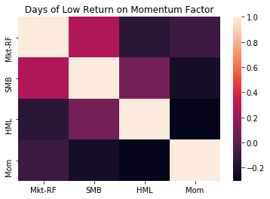
BARRA factors (2016-2019)
FAMA-FRENCH factors (2016-2019)

Slide 28
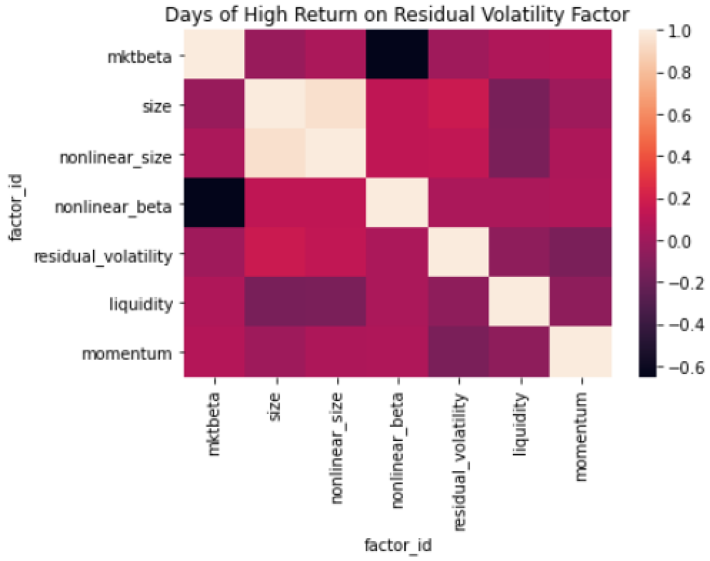
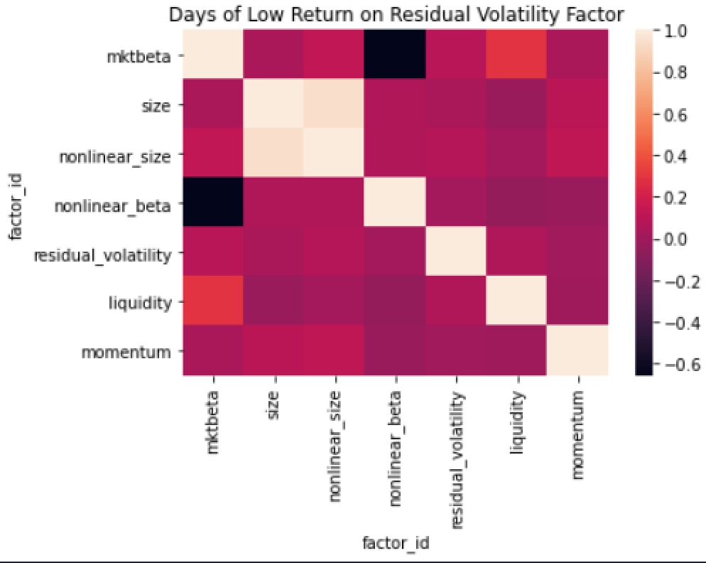
BARRA factors (2016-2019)

Slide 29
Appendix

Slide 30
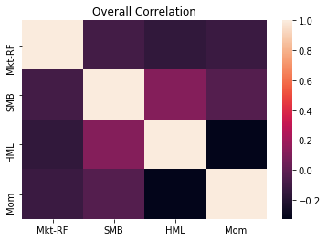
Analyzing Correlations between Fama-French factors (1963-2020)

Slide 31
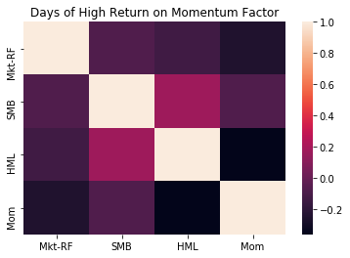
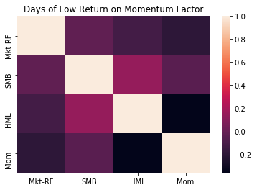
Analyzing Correlations between Fama-French factors (1963-2020)

